Slide 1
Smart Homes
Parsa Amini
November 2021
pamini@umich.edu

Slide 2
Outline
The Internet of Things (IoT)
Definition of Smart Homes
History and evolving of Smart Homes
Structure of Smart Homes
Problems and Challenges
Security
How to reduce data forgery

Slide 3
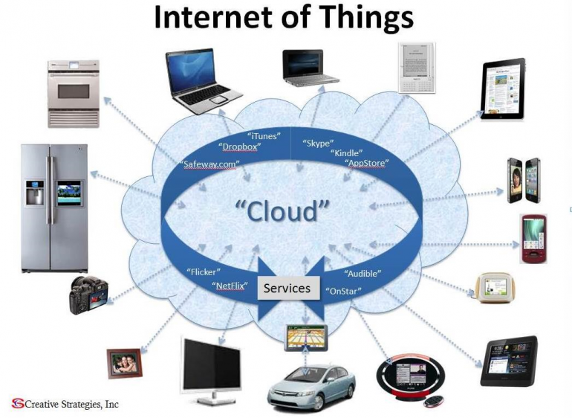
The Internet of Things (IoT)
Definition: things that are connected to the Internet and share data with each other.
Things-to-human communication
Things-to-things communication

Slide 4
What is a Smart Home? History and Evolving
A living environment, such as a home, where the household devices and appliances can be controlled automatically or remotely.
User control and monitor devices and appliances through Internet
Two parts:
Part One (Intranet):
Devices, appliances
Switches
Part Two (communicate with the Internet):
Interface devices
Data controller

Slide 5
Structure of Smart Home
Internet
Switch Module 1
Light
Switch Module 2
Fridge
Switch Module 3
TV
Smart Central Controller
Switch Module 4
Gas Stove
Switch Module 5
Others

Slide 6
Structure of Smart Home
Application Layer
Video Monitoring
Health Care
Security System
Network Layer
Internet
Sensor Layer
Sensor middle-ware
Data Processing
Self-organized Network
Sensor 1
Sensor 2
Sensor n

Slide 7
What can be done to increase security?
Module level
Authentication module controls the authenticity of applications and devices.
Smart appliance module is used to express the unique functions abstractly.
Appliance integrity module monitors other newly created or inserted modules and validates integrity

Slide 8
Problems and Challenges
Requirements for security of the network
Integrity
The smart device itself needs a security when it has access to the wireless network.
Availability/Confidentiality
All the devices and appliances send data and information on the Internet.
Access to these data should be accessible only by authorized people or devices.
Authentication
Its configurations prevents an attacker from acting maliciously within a normal network.

Slide 9
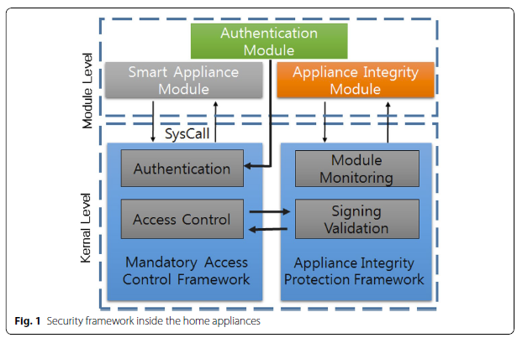
What can be done to increase security?
Architecture
Kang, W. M., Moon, S. Y., Park, J. (2017). An Enhanced security framework for home appliances in smart home. Human-centric Computing and Information Sciences.7-6. doi: 10.1186/s13673-017-0087-4

Slide 10
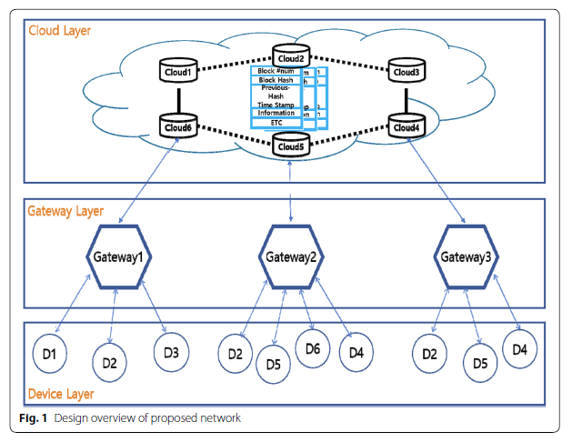
Blockchain-based Gateway Network
Lee, Y., Rathore, S., Park, J. H., Park, J., (2020). A blockchain‑based smart home gateway architecture for preventing data forgery, Human-centric Computing and Information Sciences. 10-19. doi: https://doi.org/10.1186/s13673-020-0214-5

Slide 11
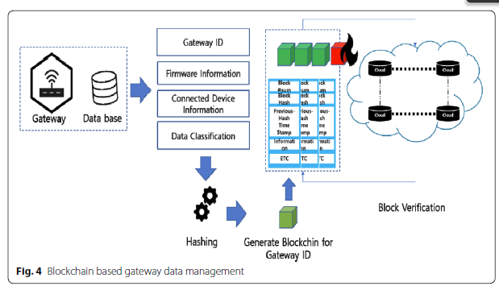
Blockchain-based Gateway Network
Identifying gateway devices and collecting data
Lee, Y., Rathore, S., Park, J. H., Park, J., (2020). A blockchain‑based smart home gateway architecture for preventing data forgery, Human-centric Computing and Information Sciences. 10-19. doi: https://doi.org/10.1186/s13673-020-0214-5

Slide 12
References
Gabhane P. J., Thakare, S., Craig, M., (2017). Smart Homes System Using Internet-of-Things: Issues, Solutions and Recent Research Directions. International Research Journal of Engineering and Technology, 4,5, 1965-1969.
Kang, W. M., Moon, S. Y., Park, J. (2017). An Enhanced security framework for home appliances in smart home. Human-centric Computing and Information Sciences.7-6. doi: 10.1186/s13673-017-0087-4
Lee, Y., Rathore, S., Park, J. H., Park, J., (2020). A blockchain‑based smart home gateway architecture for preventing data forgery, Human-centric Computing and Information Sciences. 10-19. doi: https://doi.org/10.1186/s13673-020-0214-5

Slide 13
Questions, please!

